Slide 1
Time Series Analysis
Feb 25, 2022
Gwangwoo Kim

Slide 2
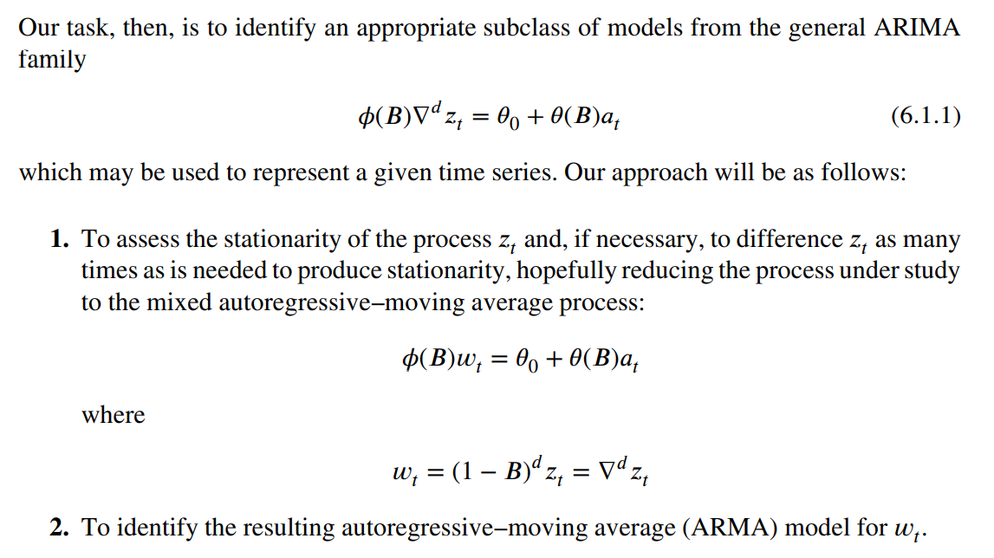
6.1.1 Stages in the Identification Procedure

Slide 3




6.2.1 Use of the Autocorrelation and Partial Autocorrelation Functions in Identification
If (p,0,q),
Let . Then
<Note> Overdifferencing is not good, because such models would have more parameters.

Slide 4
6.2.1 Use of the Autocorrelation and Partial Autocorrelation Functions in Identification
If (p,0,q),
Let . Then
<Note> Overdifferencing is not good, because such models would have more parameters.

Slide 5
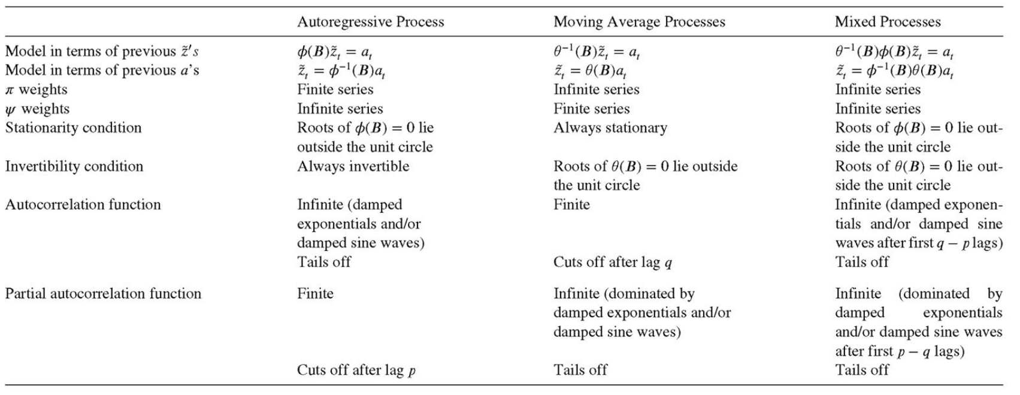
6.2.1 Identifying a Stationary ARMA Model for the Differenced Series

Slide 6
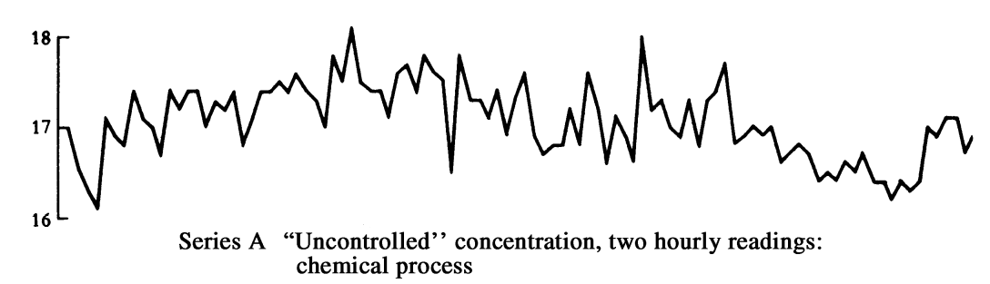
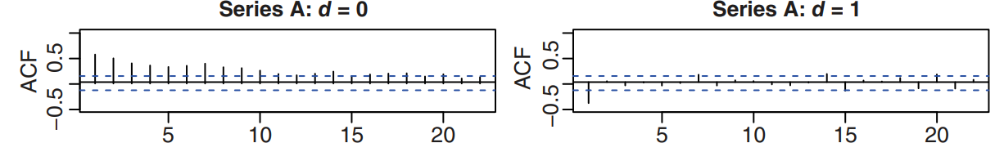
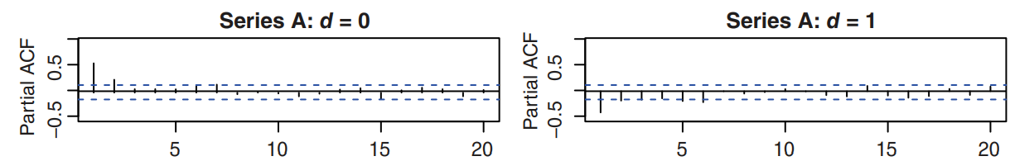
6.2.3 Identification of Models for Some Actual Time Series

Slide 7
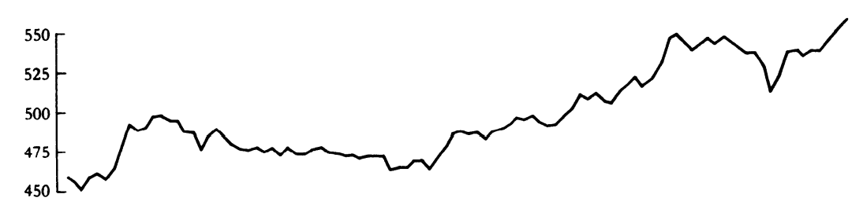
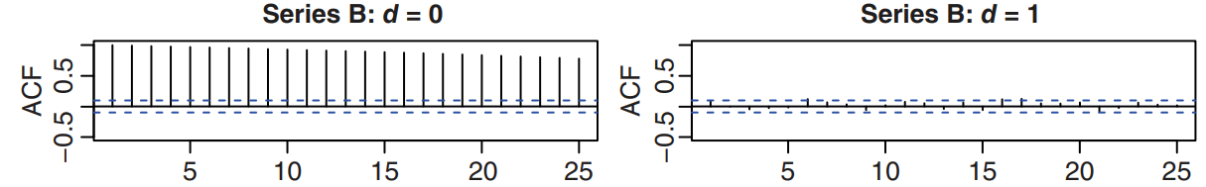
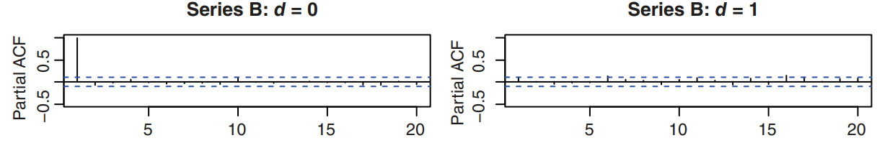
6.2.3 Identification of Models for Some Actual Time Series

Slide 8
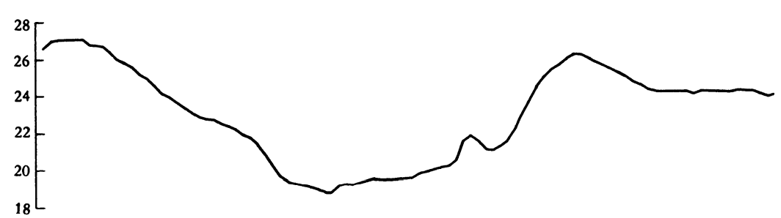
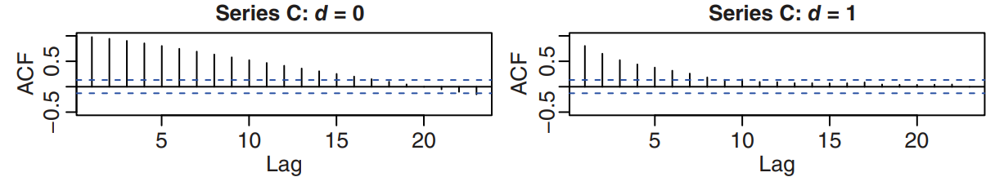
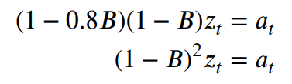
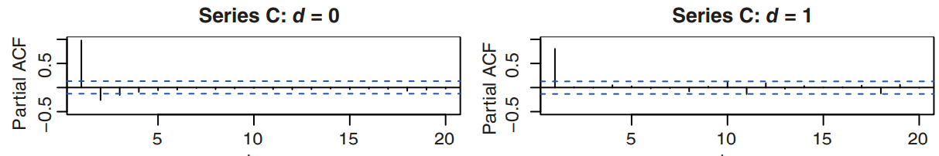
6.2.3 Identification of Models for Some Actual Time Series

Slide 9
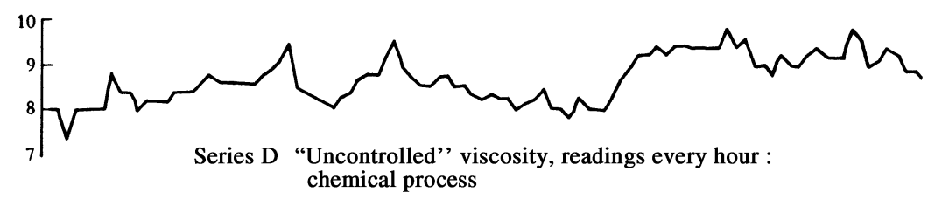
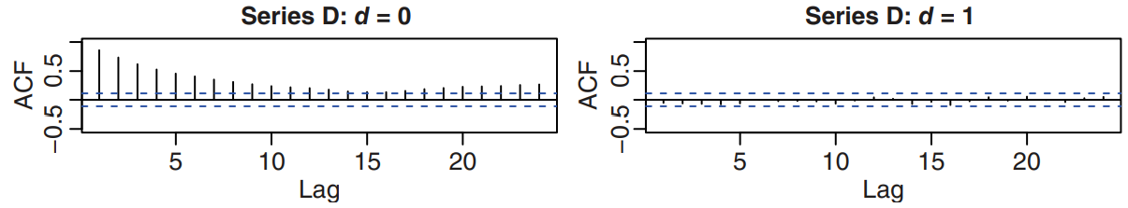
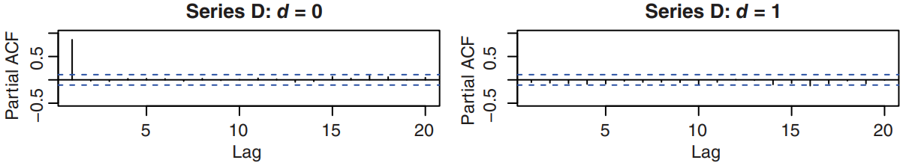
6.2.3 Identification of Models for Some Actual Time Series

Slide 10
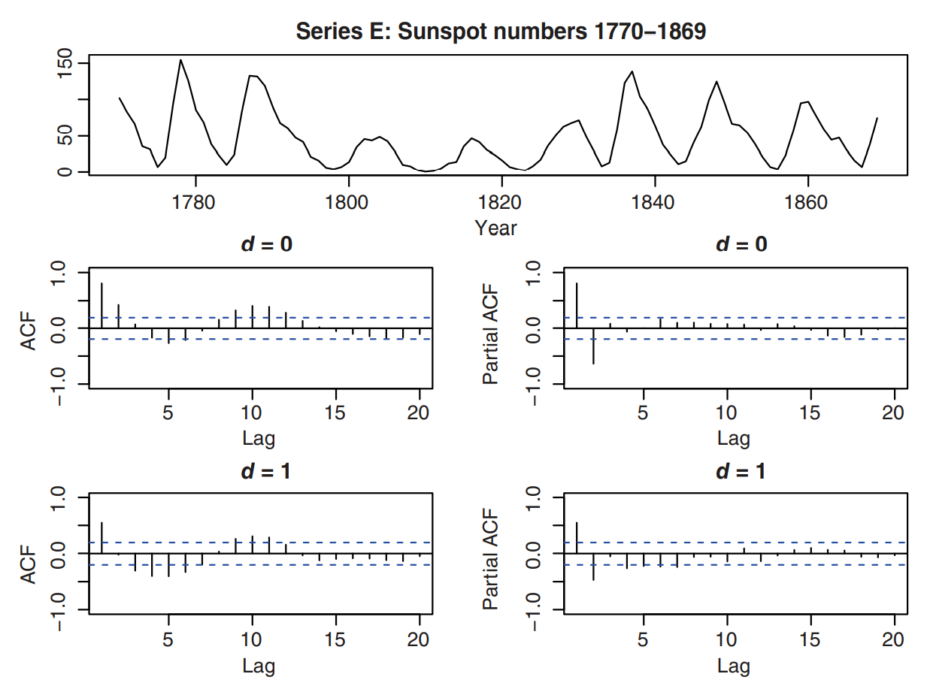
6.2.3 Identification of Models for Some Actual Time Series

Slide 11
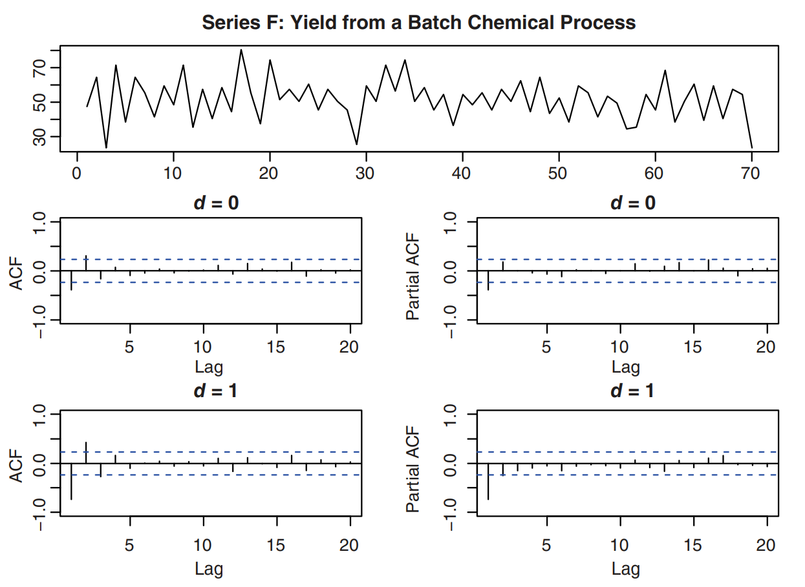
6.2.3 Identification of Models for Some Actual Time Series

Slide 12
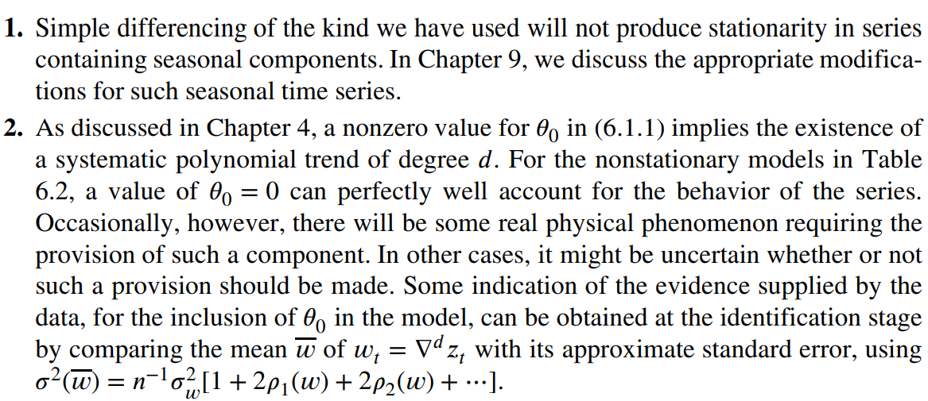
6.2.3 Identification of Models for Some Actual Time Series

Slide 13

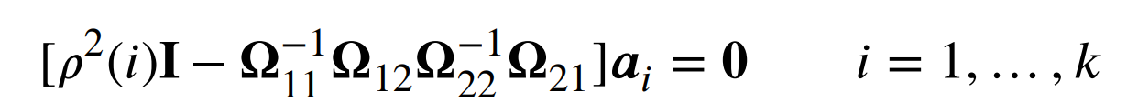
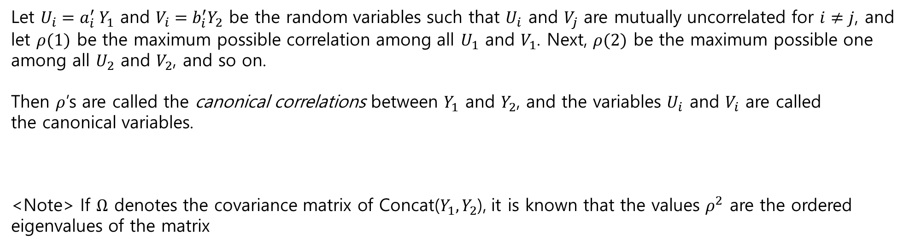
6.2.4 Some Additional Model Identification Tools
Definition (Canonical Correlations): For two random vectors
Let $U_{i}=a_{i}^{′} Y_{1}$ and $V_{i}=b_{i}^{′}Y_{2}$ be the random variables such that $U_{i}$ and $V_{j}$ are mutually uncorrelated for $i≠j$, and
let $ρ(1)$ be the maximum possible correlation among all $U_{1}$ and $V_{1}$. Next, $ρ(2)$ be the maximum possible one
among all $U_{2}$ and $V_{2}$, and so on.
Then $ρ$’s are called the canonical correlations between $Y_{1}$ and $Y_{2}$, and the variables $U_{i}$ and $V_{i}$ are called
the canonical variables.
<Note> If $Ω$ denotes the covariance matrix of Concat($Y_{1},Y_{2}$), it is known that the values $ρ^{2}$ are the ordered
eigenvalues of the matrix

Slide 14

6.2.4 Some Additional Model Identification Tools
Definition (Partial Canonical Correlations): Similarly, one can define the notion of partial canonical correlations
between $Y_{1}$ and $Y_{2}$ , given another set of variables $Y_{3}$ , as the canonical correlations between $Y_{1}$ and $Y_{2}$
after they have been ‘‘adjusted’’ for the effects of $Y_{3}$ by linear regression on $Y_{3}.$
Observation: if there exist (at least) 𝑠 ≤ 𝑘 linearly independent linear combinations of $Y_{1}$ that are completely uncorrelated with $Y_{2}$, then there are at least 𝑠 zero canonical correlations between $Y_{1}$ and $Y_{2}$.
$U=A^{′}Y_{1}$ with $Cov\left(Y_{2},U\right)=0$
there are at least 𝑠 zero canonical correlations between $Y_{1}$ and $Y_{2}$.
Since $Cov\left(Y_{2},U\right)=Ω_{21}A=0$, $s$ will be $k−r$ where $r=rank(Ω_{21})$ (?)

Slide 15

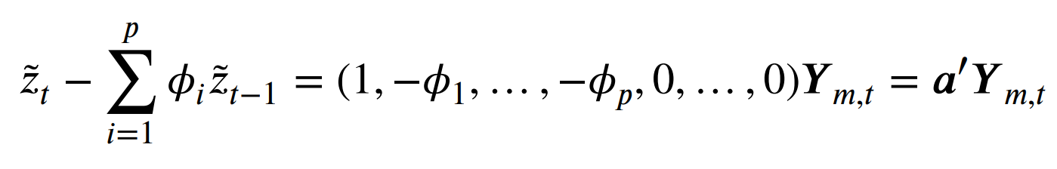
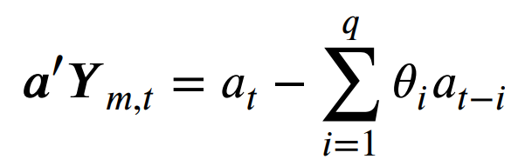
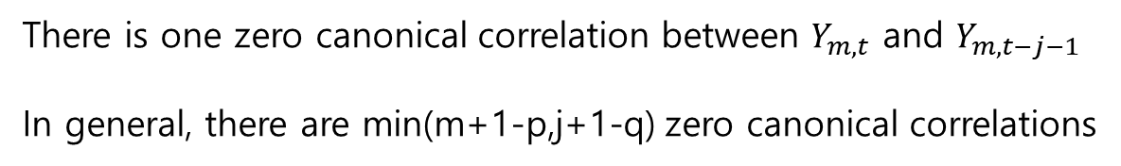


6.2.4 Some Additional Model Identification Tools
Let
In ARIMA, we have and
This is uncorrelated with $Y_{m,t−j−1}$ if $j≥q$
In particular, $j=q$
There is one zero canonical correlation between $Y_{m,t}$ and $Y_{m,t−j−1}$
In general, there are min(m+1-p,j+1-q) zero canonical correlations
The canonical correlations will be useful in model identification.

Slide 16

6.2.4 Some Additional Model Identification Tools
Let
In ARIMA, we have and
This is uncorrelated with $Y_{m,t−j−1}$ if $j≥q$
In particular, $j=q$
There is one zero canonical correlation between $Y_{m,t}$ and $Y_{m,t−j−1}$
In general, there are min(m+1-p,j+1-q) zero canonical correlations
The canonical correlations will be useful in model identification.
<Note> When m=0 or j=0, it is exactly the same as the case of ACF and PACF

Slide 17
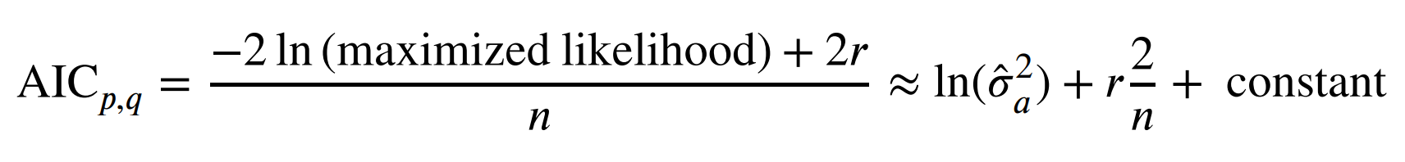
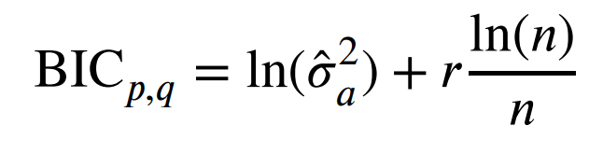
6.2.4 Use of Model Selection Criteria.
<Note> The penalty weight for r in BIC is more than in AIC,
so an optimal model induced by BIC have less parameters than one by AIC

Slide 18
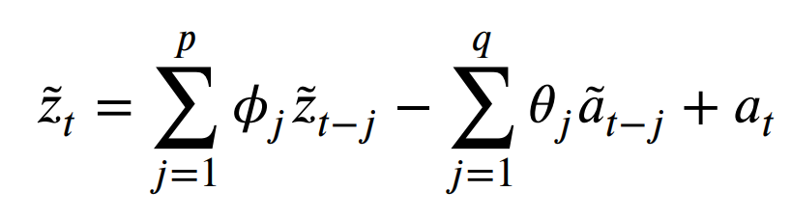

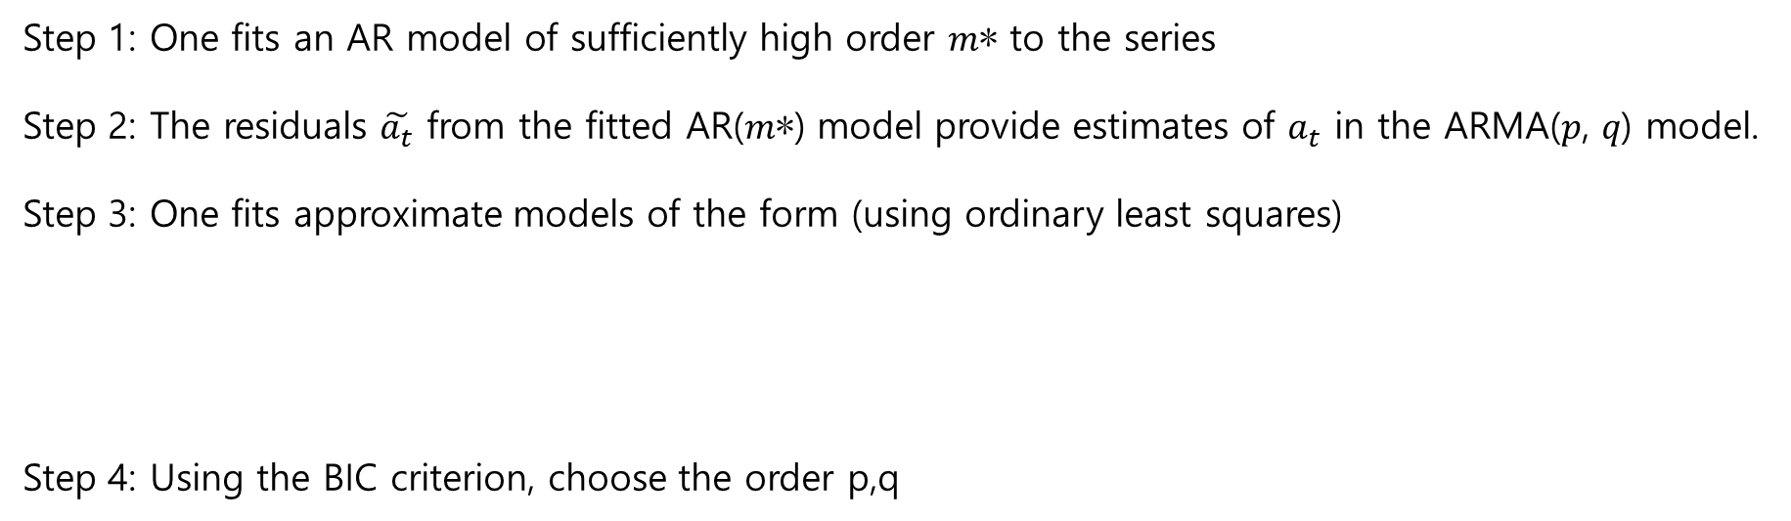
6.2.4 Use of Model Selection Criteria.
Hannan and Rissanen (1982) proposed as follows: (since it is hard to compute MLE)
Step 1: One fits an AR model of sufficiently high order 𝑚∗ to the series
Step 2: The residuals $\tilde{a_{t}}$ from the fitted AR(𝑚∗) model provide estimates of $a_{t}$ in the ARMA(𝑝, 𝑞) model.
Step 3: One fits approximate models of the form (using ordinary least squares)
Step 4: Using the BIC criterion, choose the order p,q
the estimated error variance, uncorrected for degrees of freedom

